Slide 1
Industry Project
Part II
Eatery
Eat to love, love to partake the feast
NAME: VVVSS Vijay Aditya

Slide 2
Assignment Instructions
DELIVERABLES
Part-1 - Product Analytics
Part-2 - Growth Strategies
Part-3 - Product Roadmap
Part-4 - Product Backlog and Sprint Backlog
Part-5 - Product Requirements Document
Part-6 - Go-to-Market Strategy
SUBMISSION GUIDELINES
Part-1, 2 and 6 should be submitted in this PPT document.
Part-3 and 4 should be submitted in the excel document given on the platform.
Part- 5 should be submitted in the word document given on the platform.

Slide 3
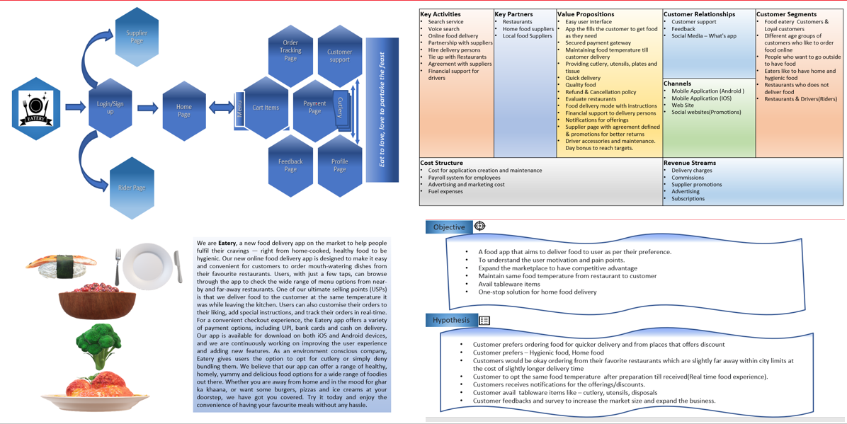
Recap assignment – Project Eatery Part 1

Slide 4
Part 1
Product Analytics

Slide 5
AARRR Framework
Acquisition
Retention
Referral
A
A
R
R
R
Find the core
Concept
Activation
Revenue

Slide 6
Acquisition Metrics

Slide 7
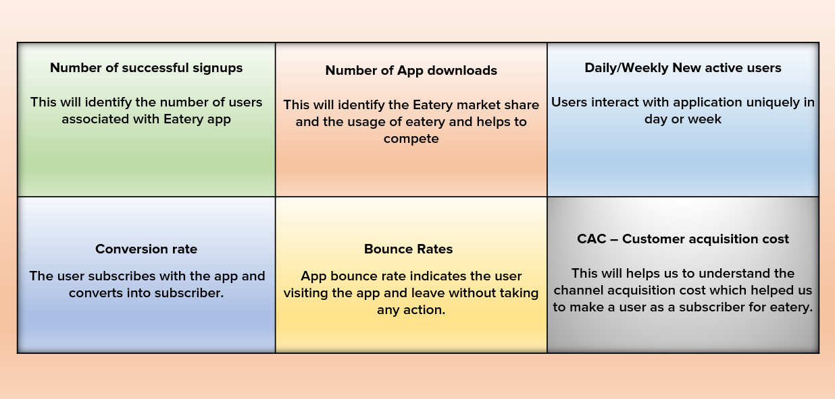
Acquisition Metrics

Slide 8
Activation Metrics

Slide 9
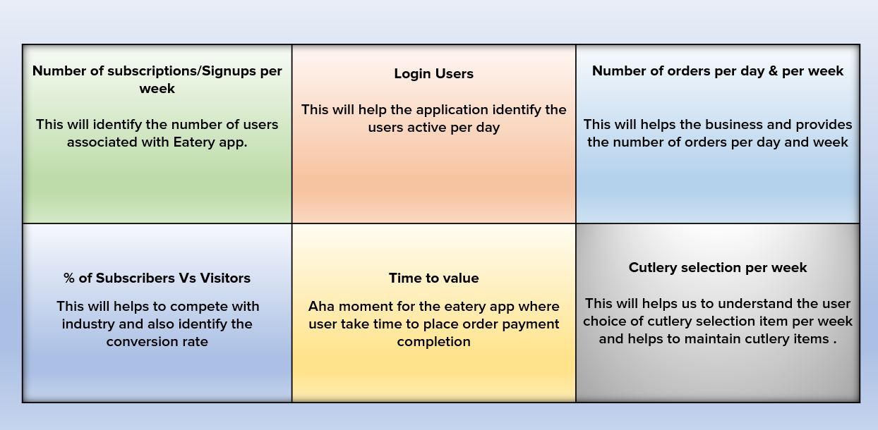
Activation Metrics

Slide 10
Retention Metrics

Slide 11
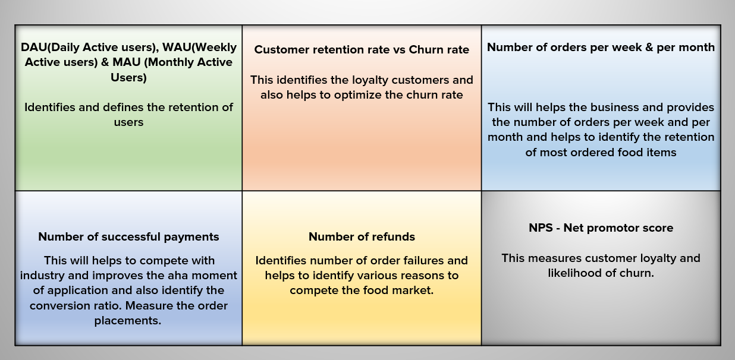
Retention Metrics

Slide 12
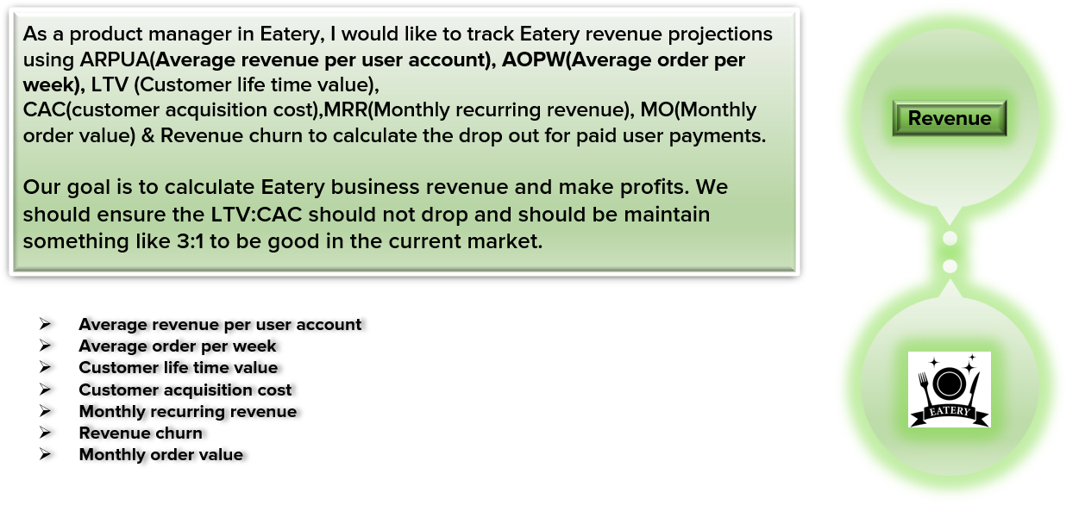
Revenue Metrics

Slide 13
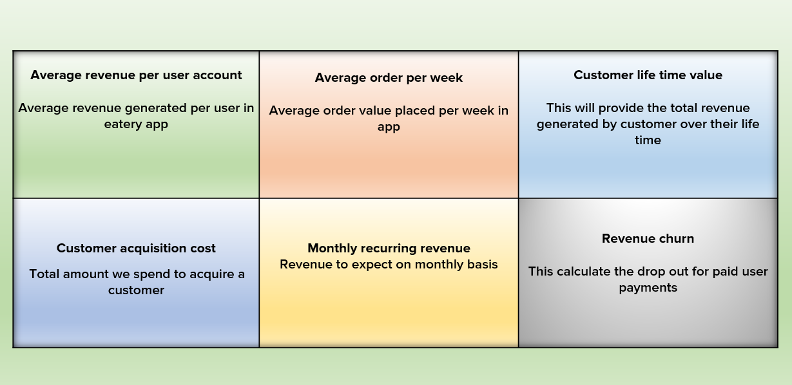
Revenue Metrics

Slide 14
Referral Metrics

Slide 15
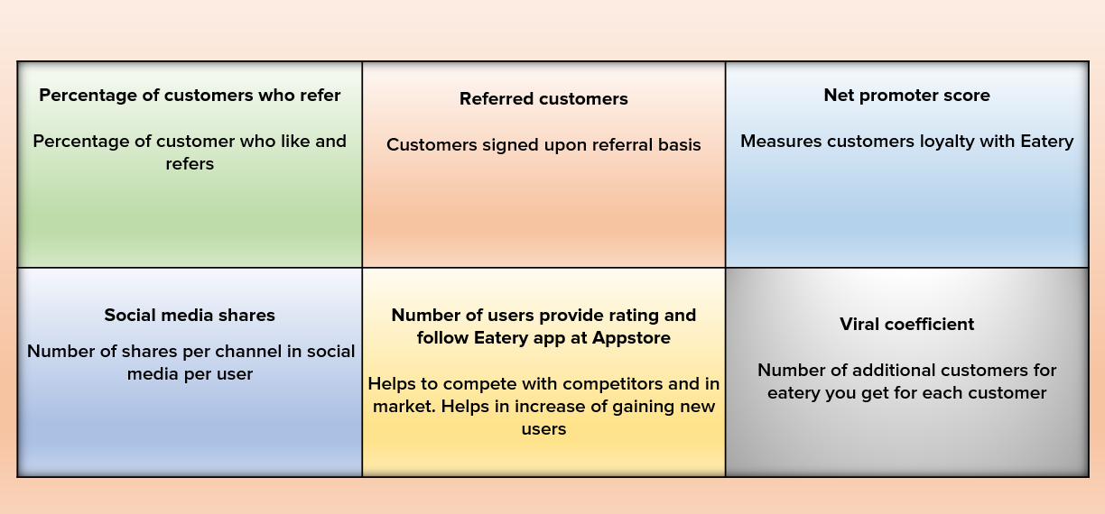
Referral Metrics

Slide 16
Eatery - Wireframe - Analytics Dashboard

Slide 17
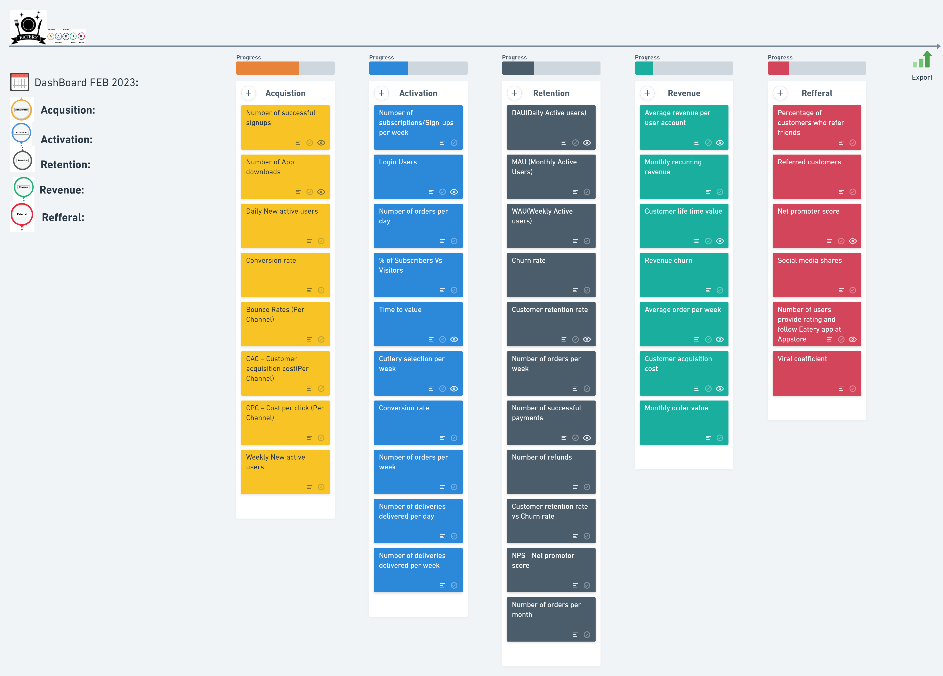
Eatery - Wireframe - Analytics Dashboard

Slide 18
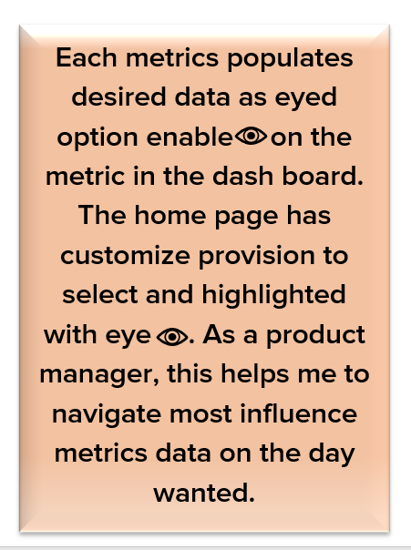
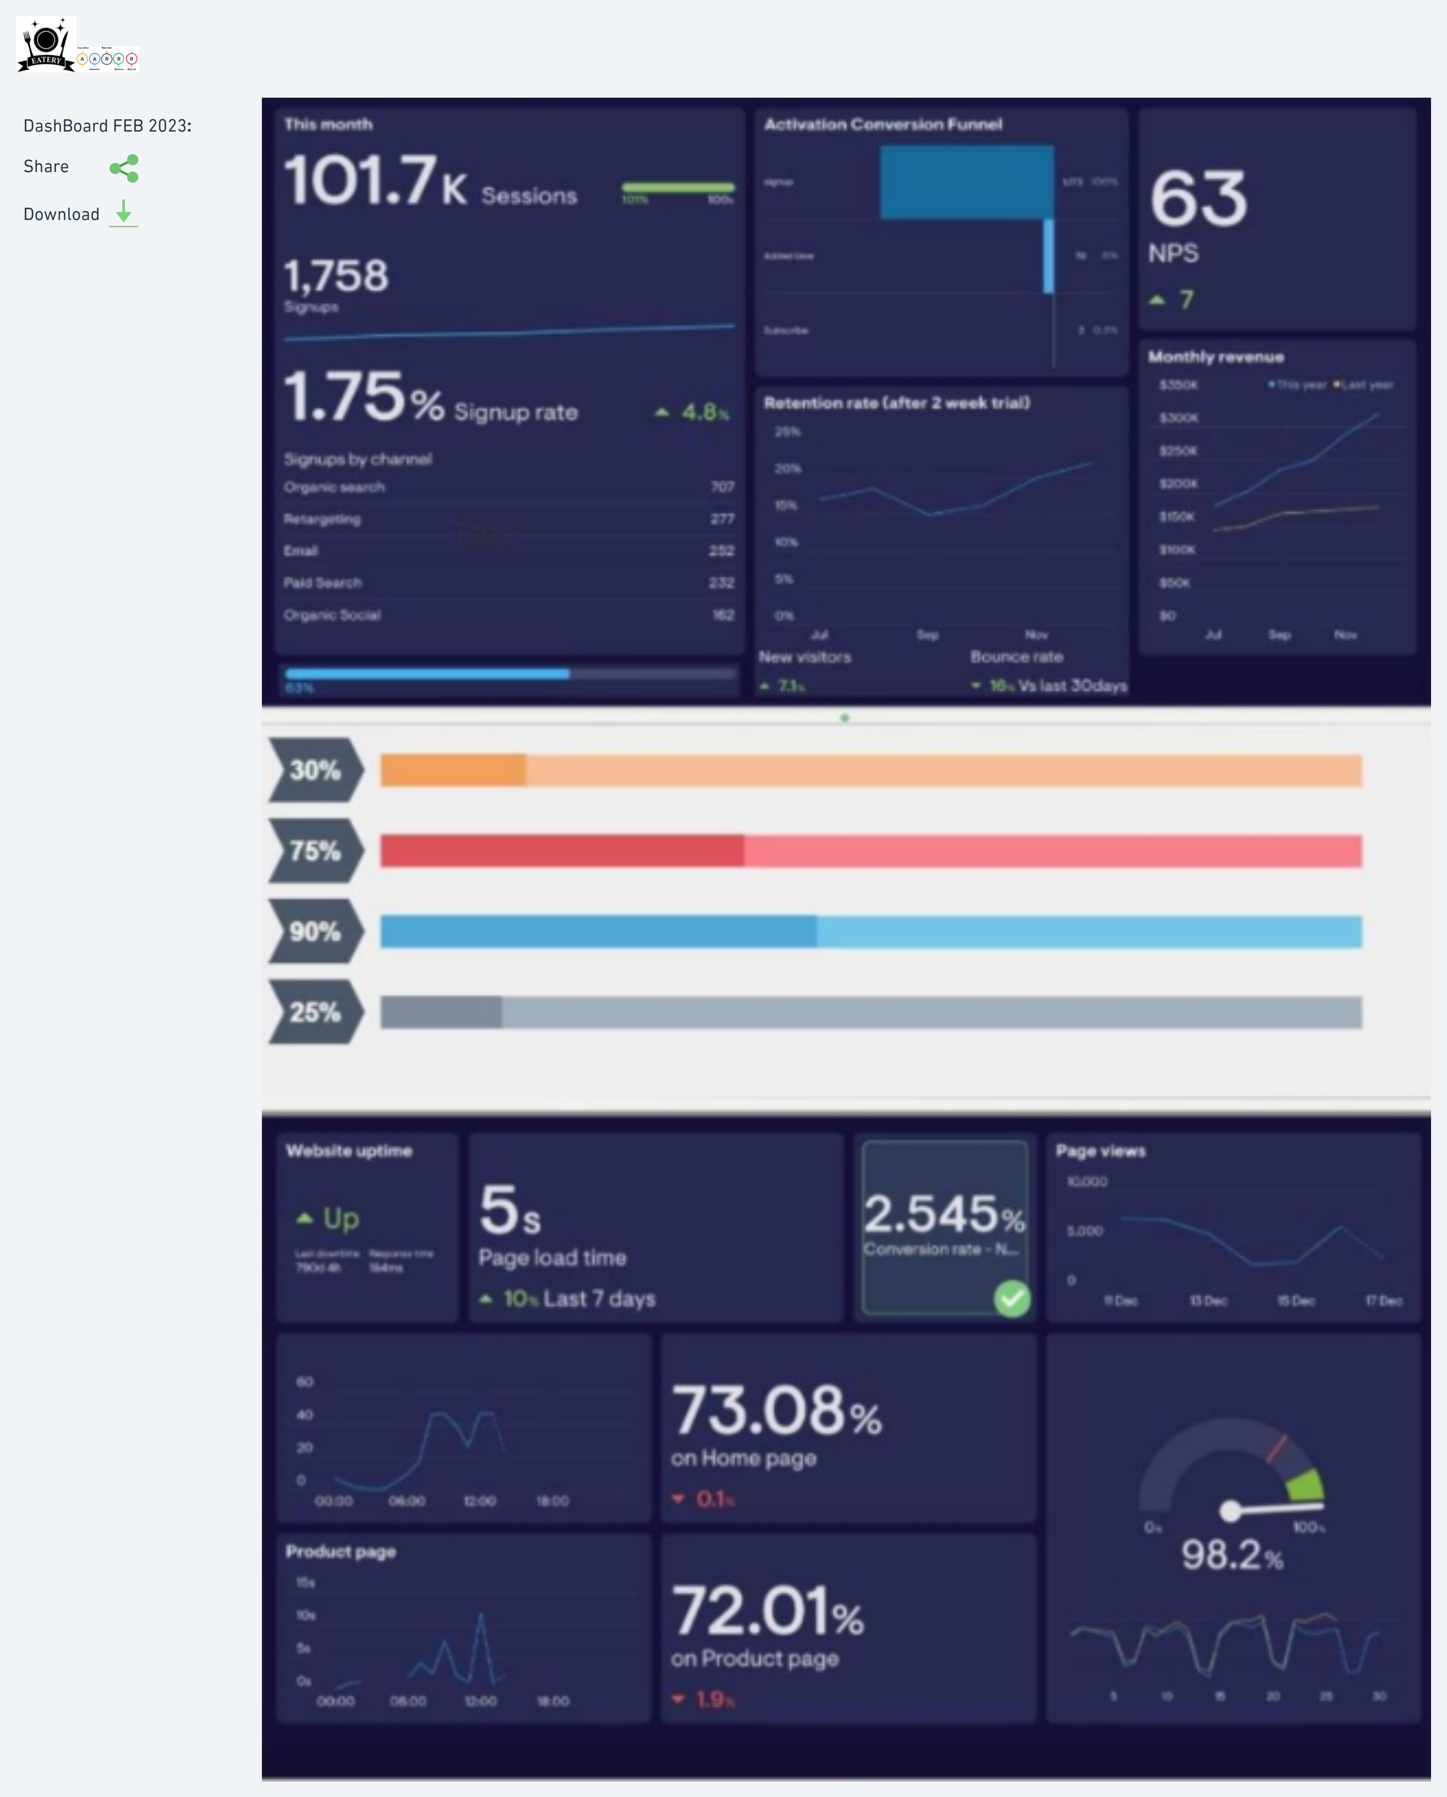
Eatery - Wireframe - Analytics Dashboard

Slide 19
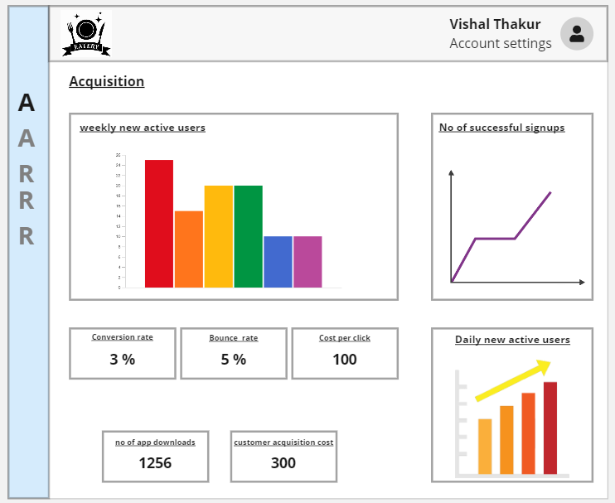
Acquisition

Slide 20
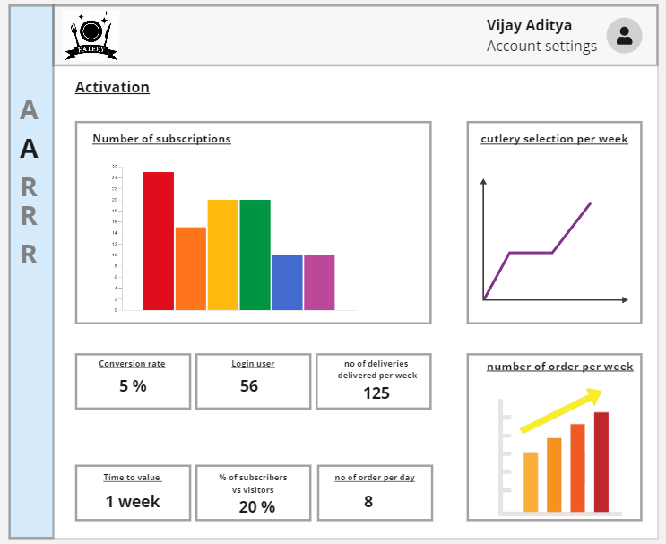
Activation

Slide 21
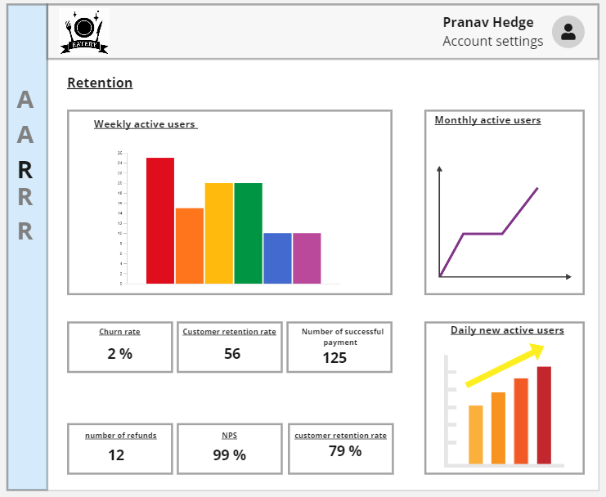
Retention

Slide 22
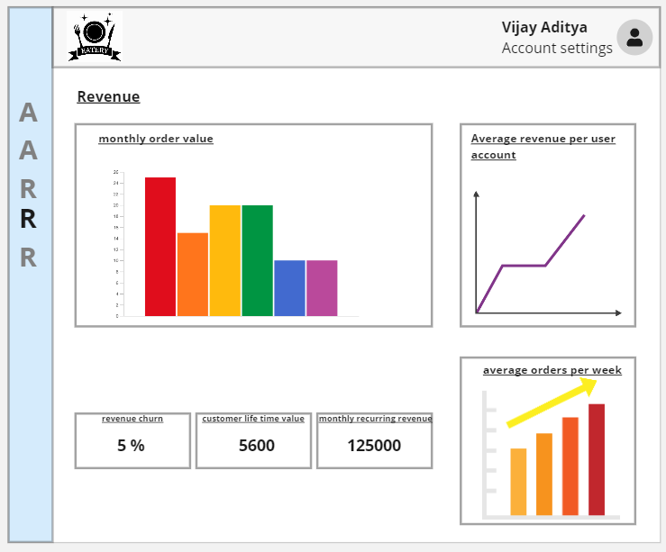
Revenue

Slide 23
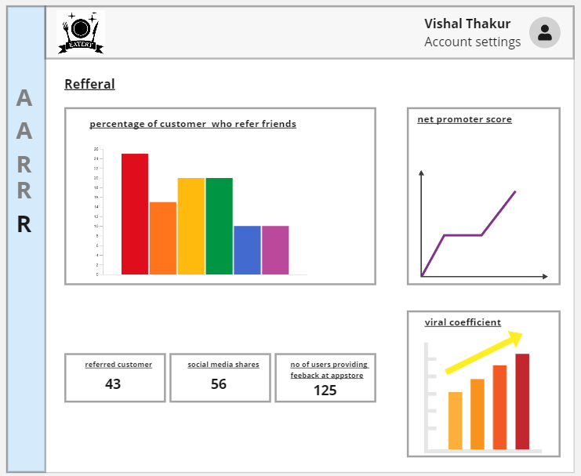
Refferal

Slide 24
Part 2
Growth Strategies

Slide 25
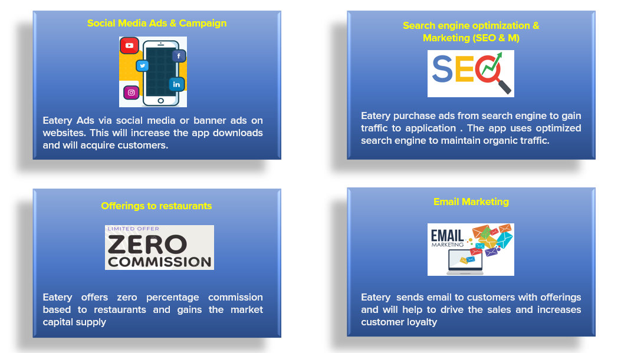
Acquisition Channels

Slide 26
Acquisition Strategy

Slide 27
Activation Channels

Slide 28
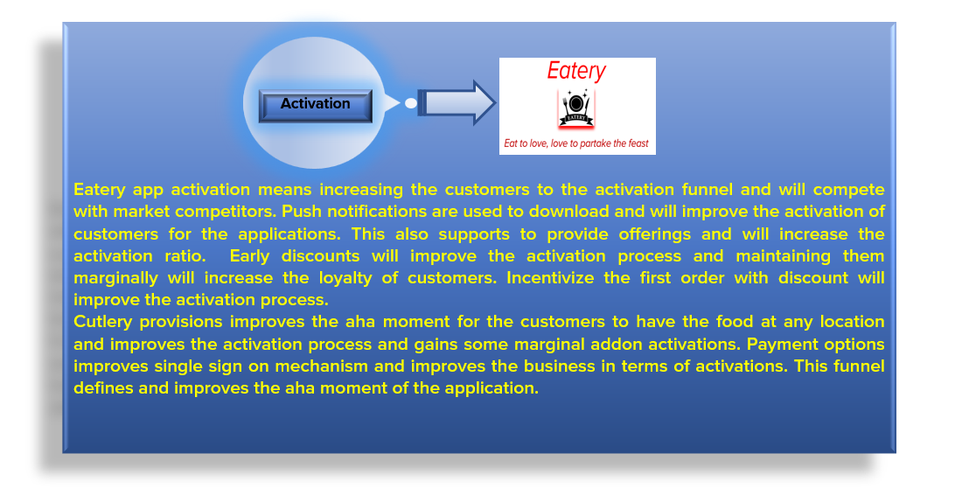
Activation Strategy

Slide 29
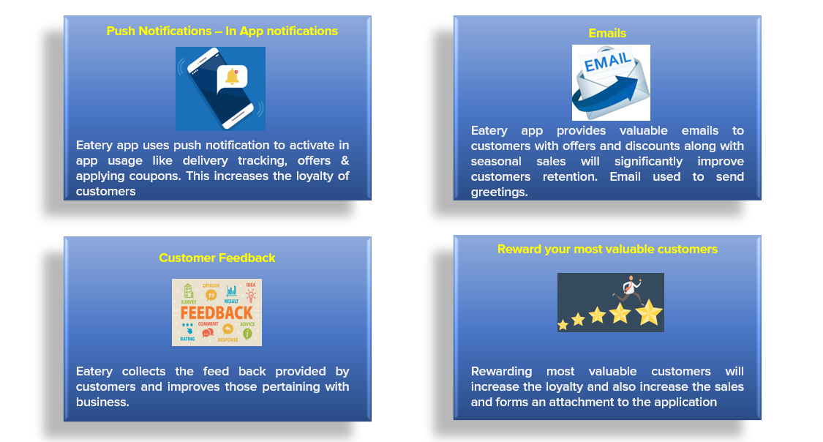
Retention and Engagement Channels

Slide 30
Retention and Engagement Strategy

Slide 31
Referral Channels

Slide 32
Referral Strategy

Slide 33
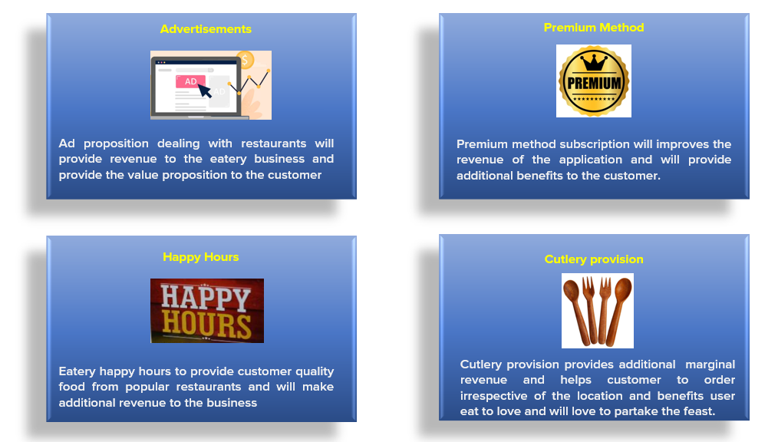
Revenue Channels

Slide 34
Revenue Strategy

Slide 35
Part 3
Product Roadmap

Slide 36
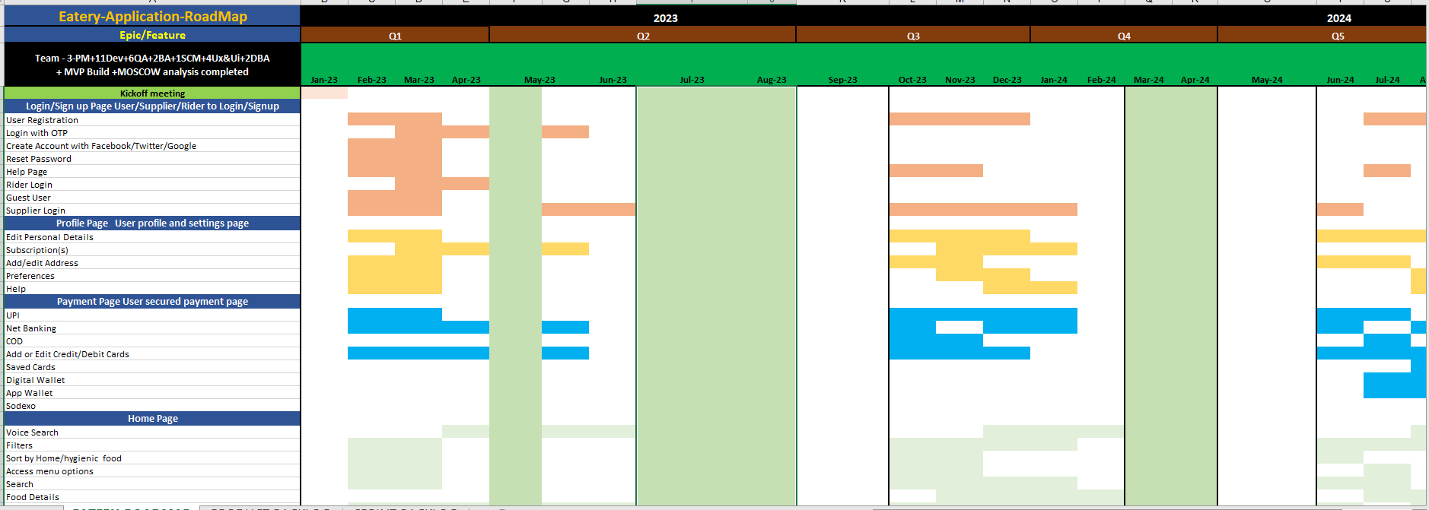
Product RoadMap
Product Roadmap https://docs.google.com/spreadsheets/d/1RXpJLZA7WhbCKLagibaZFCiWF535krao/edit#gid=529718626

Slide 37
Part 4
Product Backlog and Sprint Backlog

Slide 38
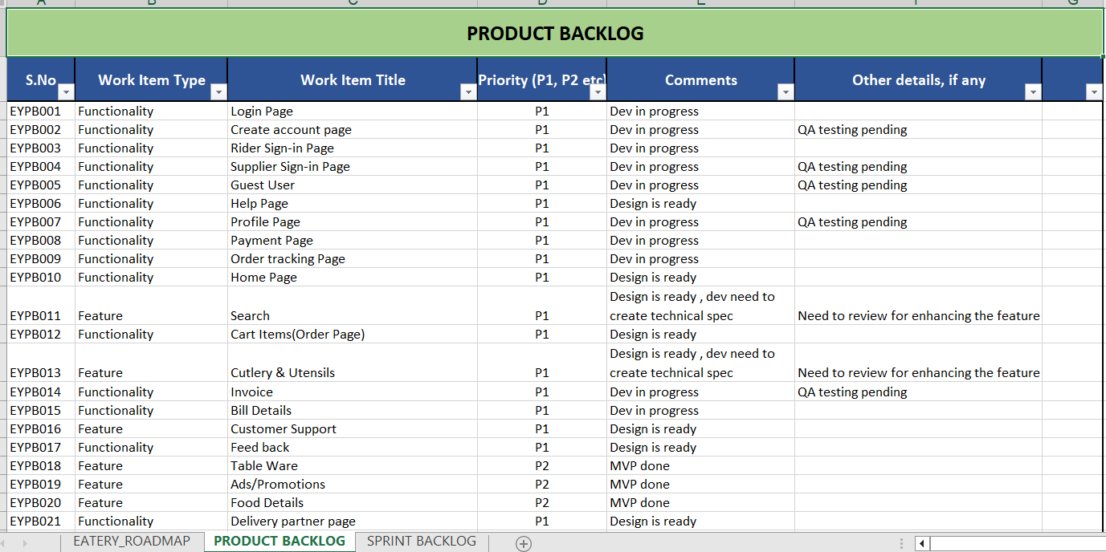
Product Backlog
Product Backlog https://docs.google.com/spreadsheets/d/1RXpJLZA7WhbCKLagibaZFCiWF535krao/edit#gid=1943901349

Slide 39
Sprint Backlog
Sprint Backlog
https://docs.google.com/spreadsheets/d/1RXpJLZA7WhbCKLagibaZFCiWF535krao/edit#gid=421986367

Slide 40
Part 5
Product Requirements Document

Slide 41
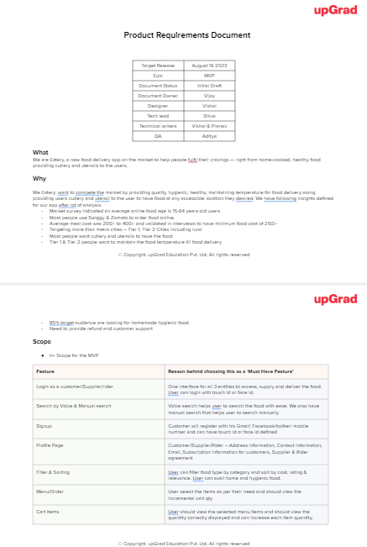
Submission Template
Product Requirements Document
https://docs.google.com/document/d/12ssp2861kXiPF-NG3BJ0HbPheGVMDFEY/edit

Slide 42
Part 6
GTM Strategy

Slide 43
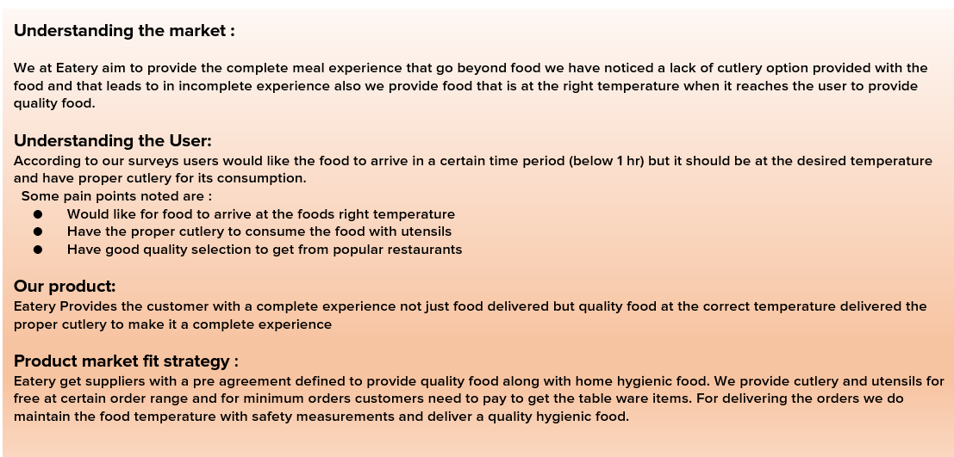
Achieving Product-Market Fit

Slide 44
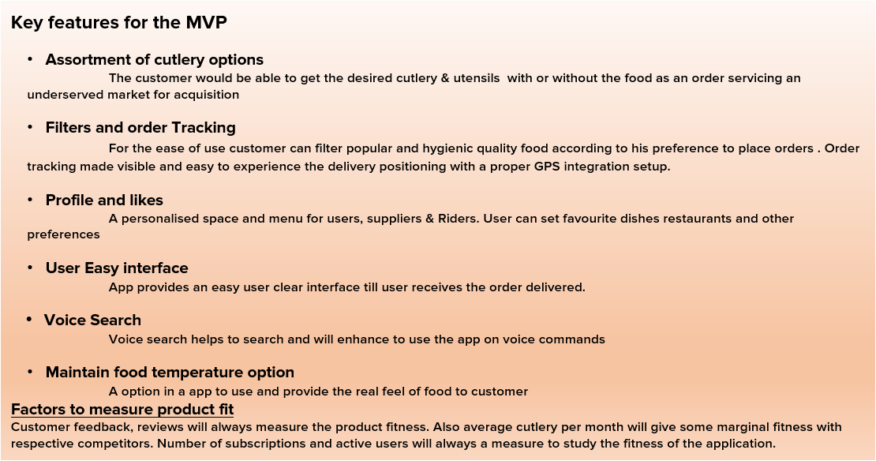
Achieving Product-Market Fit

Slide 45
Product Positioning

Slide 46
Pricing Strategy

Slide 47
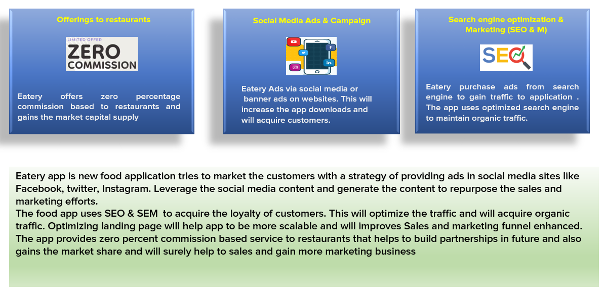
Sales & Marketing Strategy

Slide 48
Product Launch Plan

Slide 49
Product Launch Plan

Slide 50
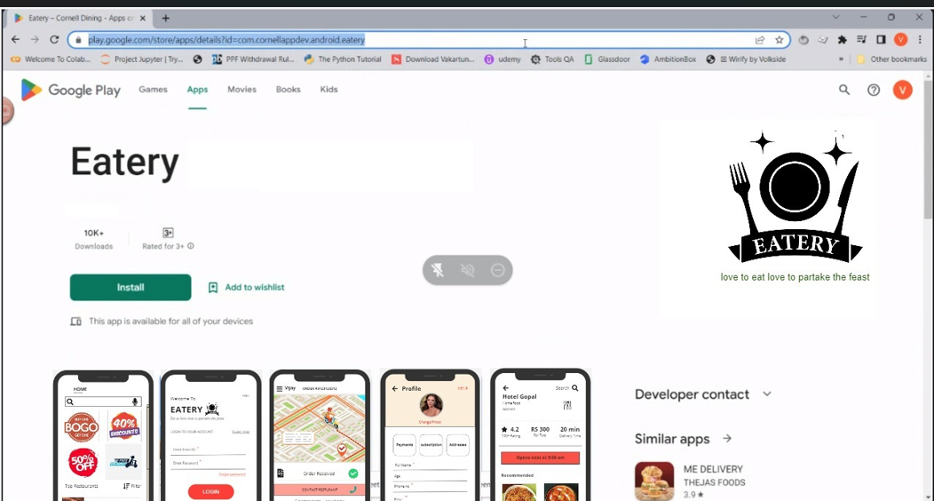
App in Play store

Slide 51
Disclaimer
All content and material on the upGrad website is copyrighted material, either belonging to upGrad or its bonafide contributors and is purely for the dissemination of education. You are permitted to access print and download extracts from this site purely for your own education only and on the following basis:-
● You can download this document from the website for self use only.
● Any copies of this document, in part or full, saved to disc or to any other storage medium may only be used for subsequent, self viewing purposes or to print an individual extract or copy for non commercial personal use only.
● Any further dissemination, distribution, reproduction, copying of the content of the document herein or the uploading thereof on other websites or use of content for any other commercial/unauthorized purposes in any way which could infringe the intellectual property rights of upGrad or its contributors, is strictly prohibited.
● No graphics, images or photographs from any accompanying text in this document will be used separately for unauthorised purposes.
● No material in this document will be modified, adapted or altered in any way.
● No part of this document or upGrad content may be reproduced or stored in any other web site or included in any public or private electronic retrieval system or service without upGrad’s prior written permission.
● Any rights not expressly granted in these terms are reserved.

