Slide 1
Product Management
Certification Program
Industry Project – I
Eatery
Eat to love, love to partake the feast
Notes:
© Copyright UpGrad Education Pvt. Ltd. All rights reserved

Slide 2
Submission Guidelines
After completing all the parts of the project, you will have to submit your responses in the following manner.
Submit the following parts of the project in this “Presentation’’ file
Part 1 - Understanding the market
Part 2 - User research
Part 5 - MVP Creation
Part 6 - Sketching
Part 7 - Wireframing & Prototyping
Submit the following part of the project in the template document provided on the platform.
Part 3 - Business Model Canvas
Part 4 - Product Artifacts
User Persona
User Journey Map
Note: Finally you have to add this Presentation & other submission documents in a ZIP folder and upload it in the submission section on the platform. More details in slides to follow
Notes:
© Copyright UpGrad Education Pvt. Ltd. All rights reserved

Slide 3
Part 1: Understanding the Market
Notes:
© Copyright UpGrad Education Pvt. Ltd. All rights reserved

Slide 4
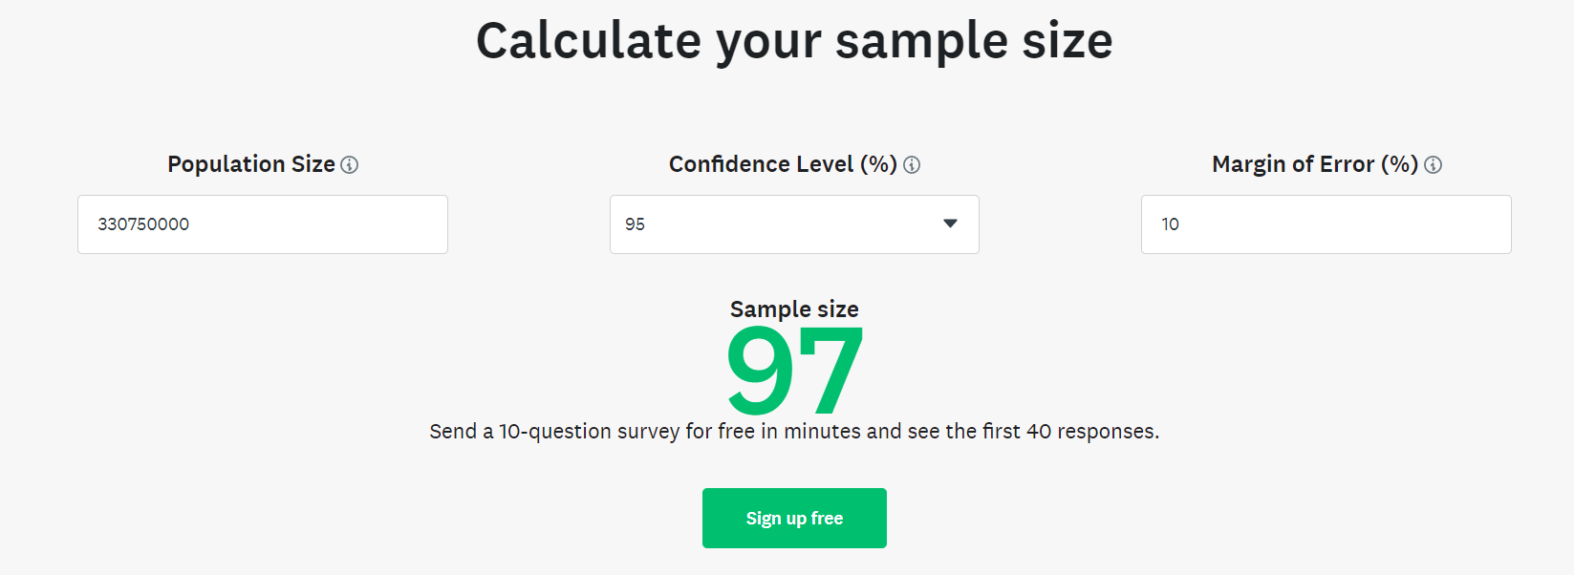
Target Market Identification
Target Market – We are targeting urban cities in India market with age group of 15-64 having a mobile with each targeted person. Urban serviceable market we are assuming 35% of TAM and the audience age group is 67% of urban serviceable market.
Sample size calculator (Sample survey)
Confidence level=95%
Margin of error= 10%
Sample survey Size = 97(survey monkey)
Total number of people to be surveyed = 97/10%=970
For the required target of 30 responses, we need to survey 300 people
Target number of people to be surveyed = 30 *970/97 = 300
Need to survey 300 people for 30 responses
Notes:
© Copyright UpGrad Education Pvt. Ltd. All rights reserved

Slide 5
Target audience to start the business
Target Audience – From urban we are targeting audience from south India, starting with Hyderabad where we are assuming 3% of target audience to begin the food app service.
Sample size calculator (Sample survey)
Confidence level=95%
Margin of error= 10%
Sample survey Size = 97(survey monkey)
Total number of people to be surveyed = 97/10%=970
For the required target of 30 responses, we need to survey 300 people
Target number of people to be surveyed = 30 *970/97 = 300
Need to survey 300 people for 30 responses

Slide 6
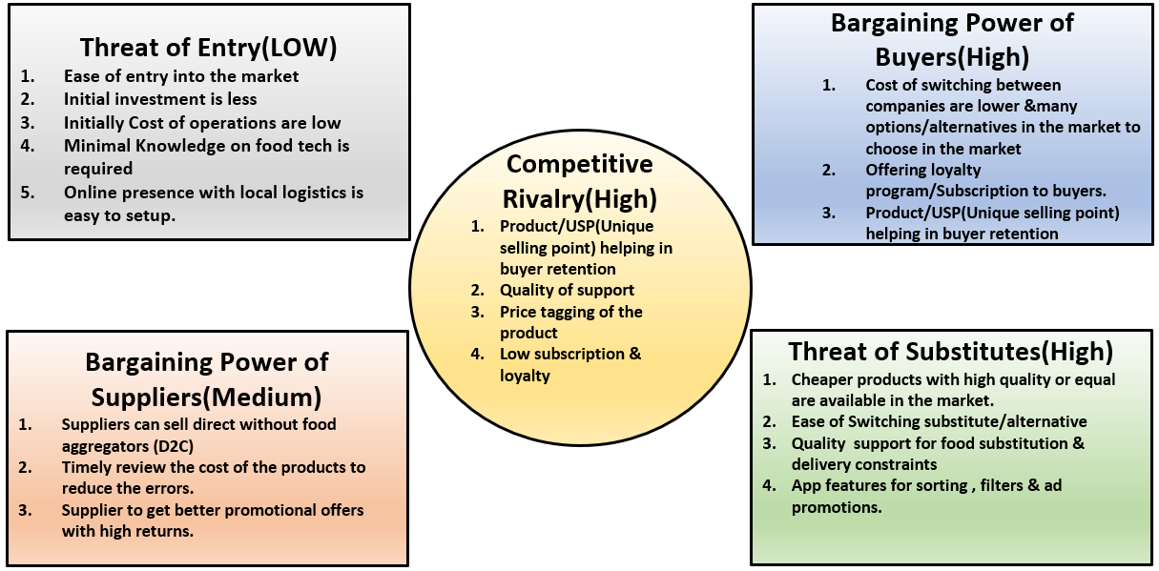
Porter's Five Forces
Notes:
© Copyright UpGrad Education Pvt. Ltd. All rights reserved

Slide 7
Porter's Five Forces Analysis
Five Forces | Analysis
Threat of New Entry(Low) | It is easier to enter with minimal knowledge into with market and with a low budget. We will have huge competition. We will have barricades initially to overcome and to turn into profitable.
Bargaining Power of Buyers(High) | Market have sustainable buyers. Cost switching with products being changed. Need to provide offerings for better returns.
Threat of Substitutes(High) | Being high branded items can be substituted with lower quality food. Delivery substitutions with low quality will have high impact
Bargaining Power of Suppliers(Medium) | Supplier loyalty switches for more offerings from competitors
Competitive Rivalry(High) | High market competitive rivalry with low offerings
Notes:
© Copyright UpGrad Education Pvt. Ltd. All rights reserved

Slide 8
Competitor Analysis – Direct & Indirect
Direct Competitors
Indirect Competitors
DC1
DC2
Notes:
© Copyright UpGrad Education Pvt. Ltd. All rights reserved

Slide 9
Zomato vs Swiggy
Swiggy Founder: Sriharsha Majety, Nandan Reddy, Rahul Jamini Founded: 2014 HQ: Bengaluru, India No. of Employees: Over 5,000 Company type: Private Market Valuation: $10.7 billion Annual Revenue: Rs 2,145 crore Net profit: Not profitable yet. ( - Rs 1,314 crore)
Zomato Founder Deepinder Goyal and
Pankaj Chaddah Year Founded 2008 Origin Gurgaon, Haryana, India No. of Employees 5,000+ Company Type Public Market Cap $13.3 Billion Annual Revenue $280 Million Net Profit $ -110 Million
Continued …

Slide 10
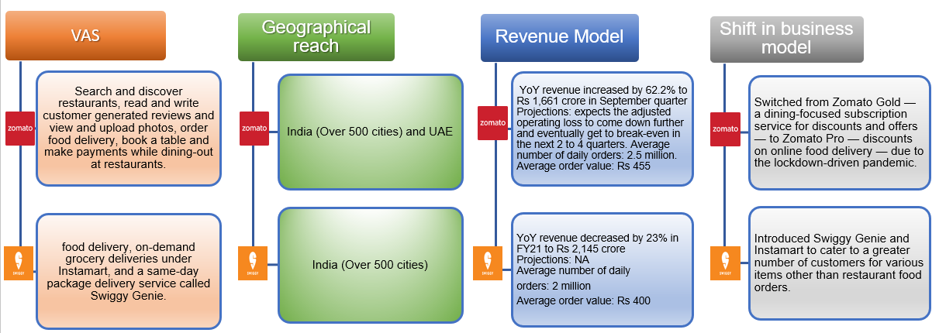
Comparision DC1 vs DC2
Continued …

Slide 11
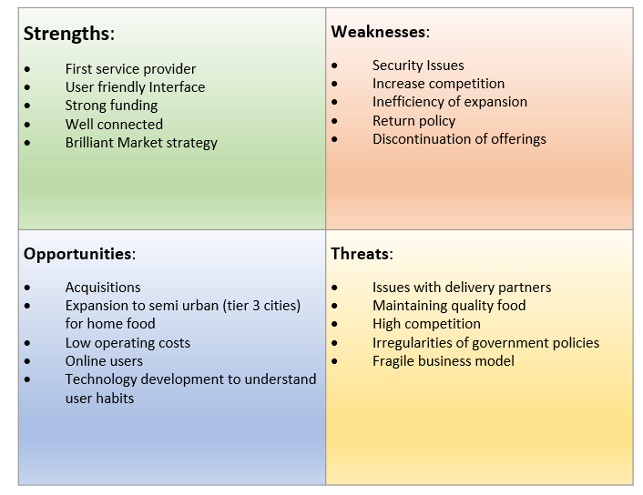
SWOT Analysis – Zomato(DC1)

Slide 12
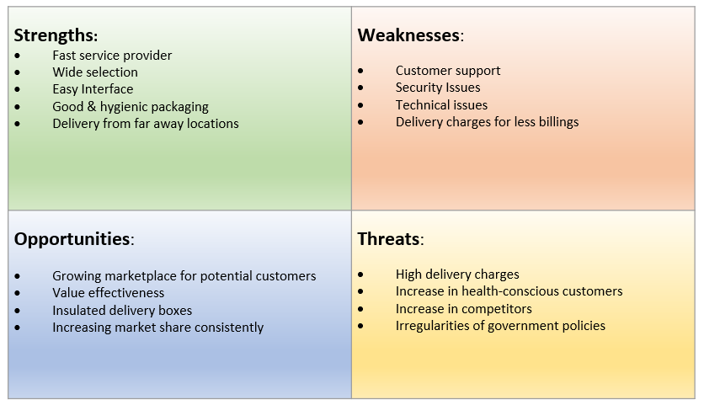
SWOT Analysis – Swiggy(DC2)

Slide 13
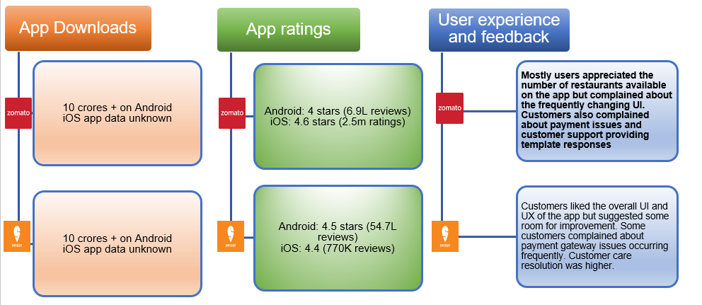
Product review and performance

Slide 14
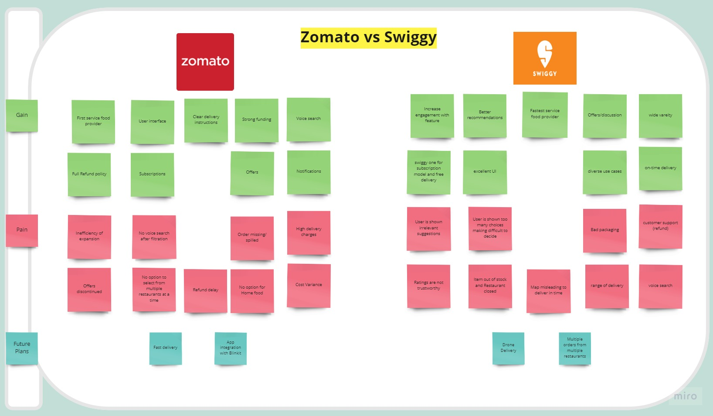
Pain & Gains & Future initiatives

Slide 15
Part 2: User Research
Notes:
© Copyright UpGrad Education Pvt. Ltd. All rights reserved

Slide 16
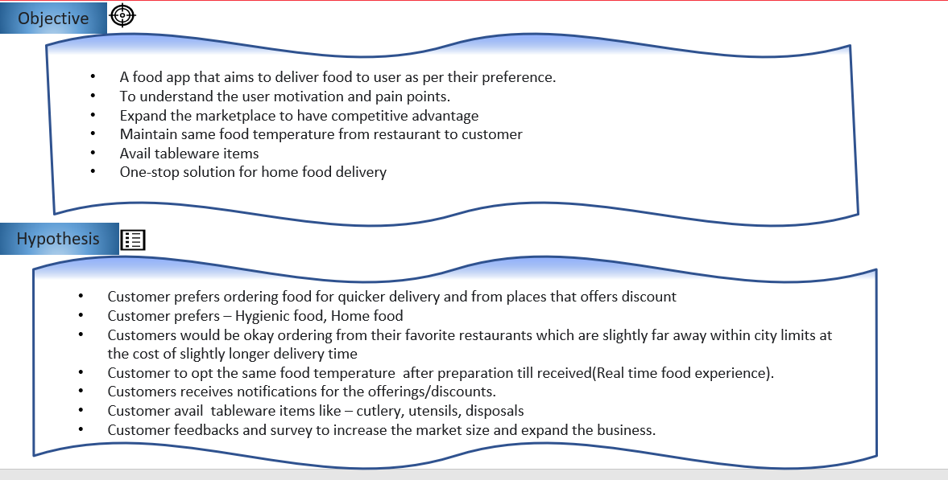
Objectives and Hypotheses
Notes:
© Copyright UpGrad Education Pvt. Ltd. All rights reserved

Slide 17
Surveys & Interviews
Survey Questions
https://forms.gle/CSdrnGuGA16qcNLE6
Survey Response
https://docs.google.com/spreadsheets/d/1-JF8O3RVSDfG0YYCNvuF2J_2KDHaomnz4IdpZdsLS44/edit?resourcekey#gid=250944910
Interview Questions
https://docs.google.com/document/d/1P7VfTZmnkfzCGS2TVEyQlDYPSDCmkm8SlCVEg9jGccI/edit?usp=sharing
Interview Response
https://docs.google.com/document/d/1c24MICx-pdeq03qYVbsK-ZU2fHWBLTd_LaL0ySgZzRI/edit

Slide 18
Survey & Interview – Analysis & Insights
We Conducted 45 surveys. As our business plan is target from the city, Hyderabad and we have received 22 responses from target audience who stays in Hyderabad. We took 11 interviews in whom 1 resident from Hyderabad and 3 were non residents but stays in Hyderabad.
Demographics
Hyderabad
49%
Target Audience
45 Surveys
Mumbai
49%
Pain Points/Challenges
11 Interviews
Delhi
Goals
Demographics
Urban Cities
Notes:
© Copyright UpGrad Education Pvt. Ltd. All rights reserved

Slide 19
Pain Points
Poor Quality Food
Late Delivery
Restaurant Choice & Menu options
Food temperature
Customer Support
Discounts
Hygienic Food
Packaging
High Pricing

Slide 20
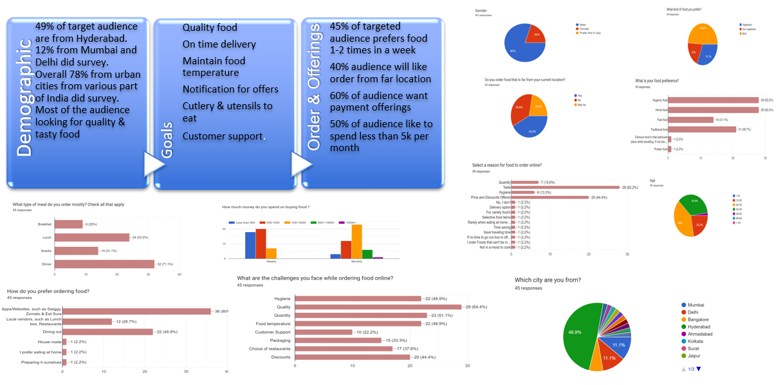
Survey analysis

Slide 21
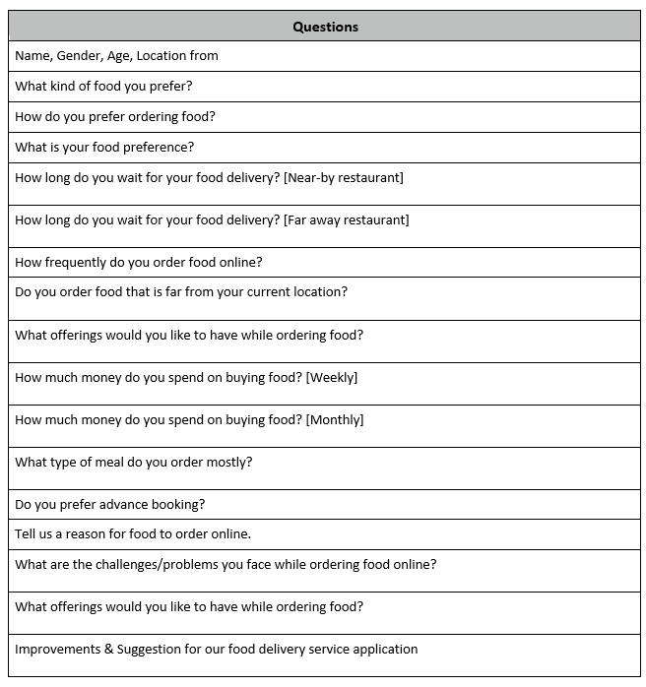
Interviews- Questions
Notes:
© Copyright UpGrad Education Pvt. Ltd. All rights reserved

Slide 22
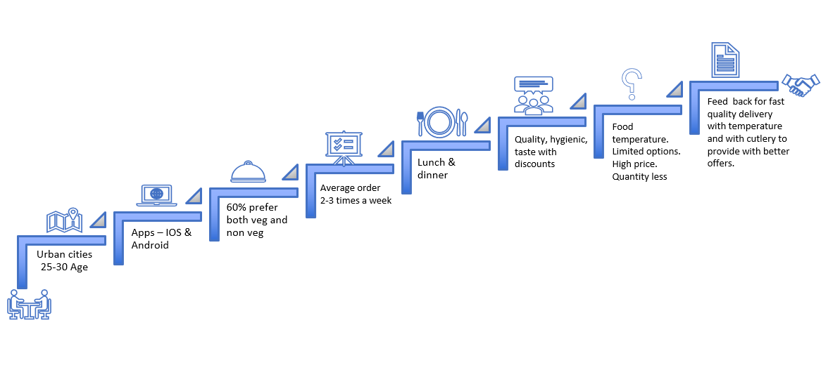
Interviews insight

Slide 23
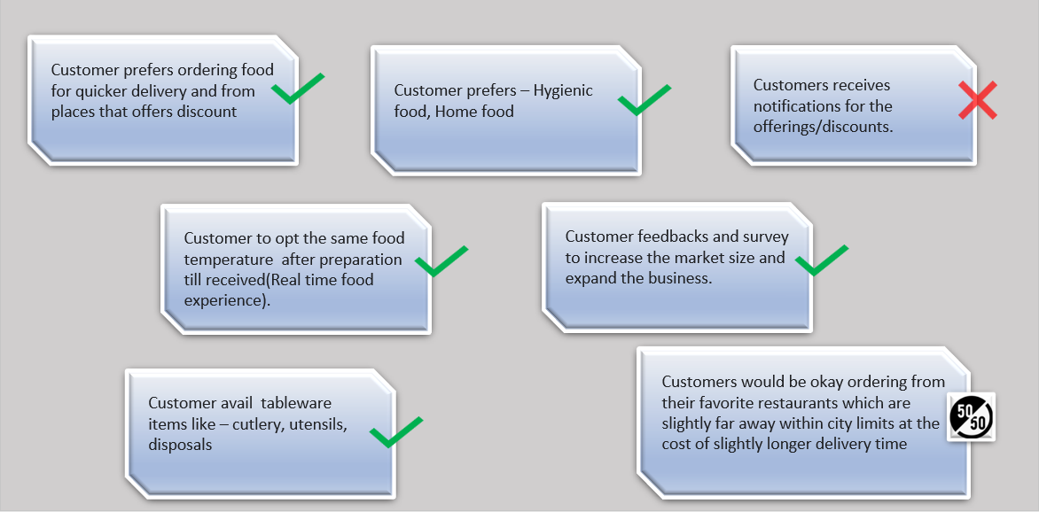
Hypothesis Validation

Slide 24
Part 3: Business Model Canvas
Notes:
© Copyright UpGrad Education Pvt. Ltd. All rights reserved

Slide 25
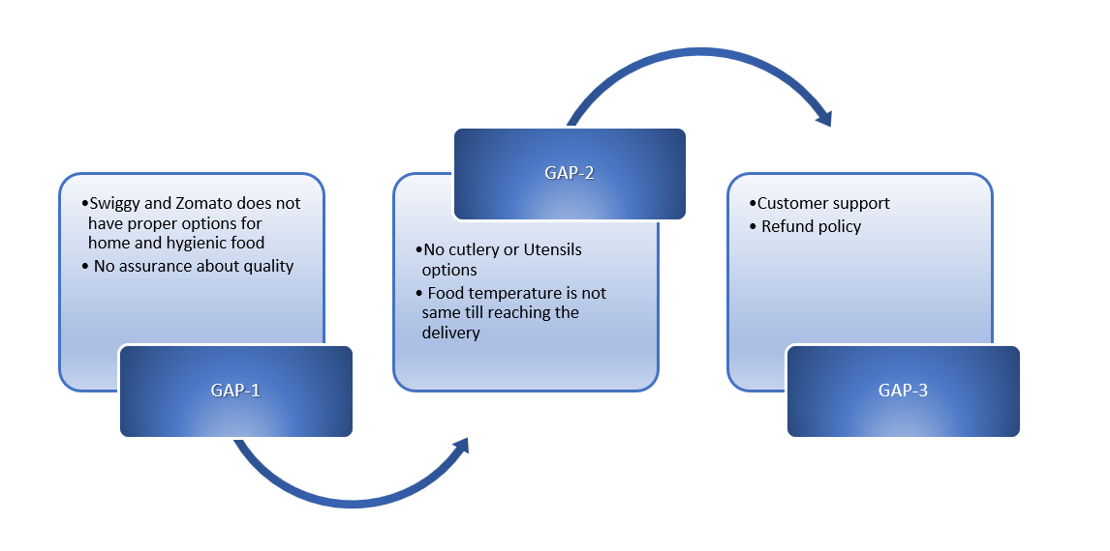
Business Model Analysis
Notes:
© Copyright UpGrad Education Pvt. Ltd. All rights reserved

Slide 26
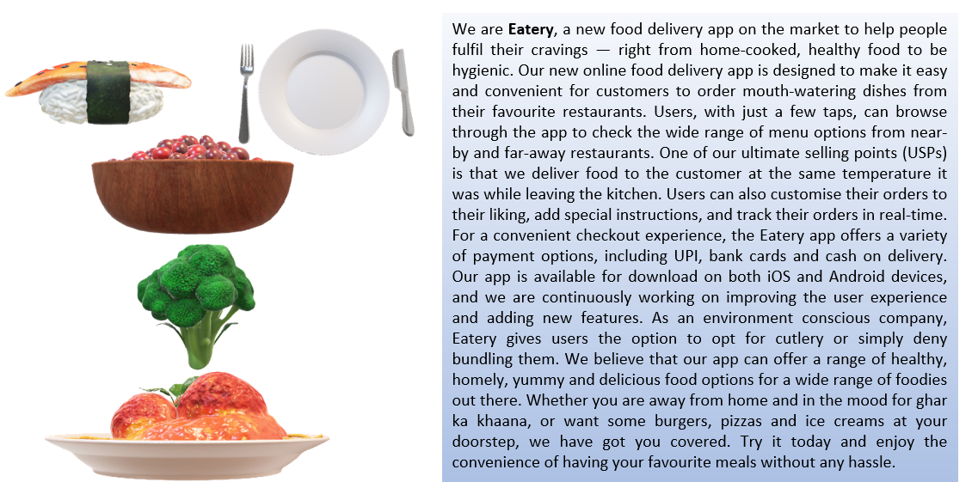
Business Model Canvas

Slide 27
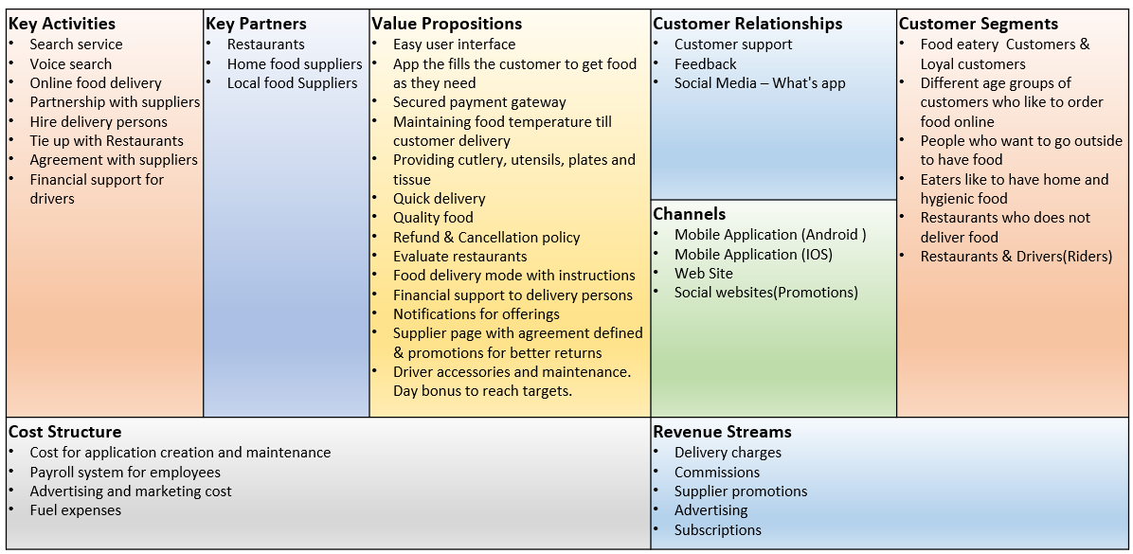
BUSINESS MODEL CANVAS

Slide 28
Part 4: Product Artefacts
Notes:
© Copyright UpGrad Education Pvt. Ltd. All rights reserved

Slide 29
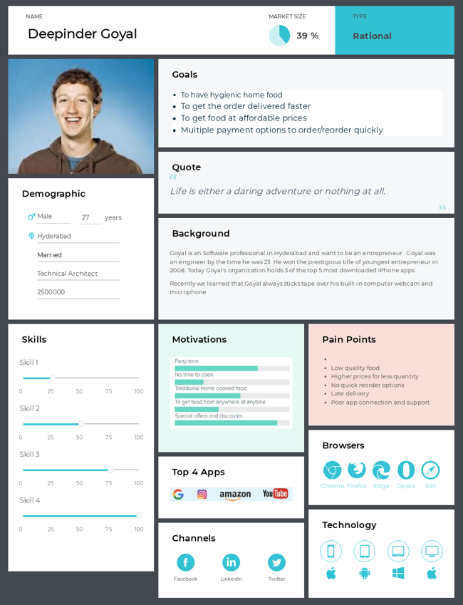
User Persona
Notes:
© Copyright UpGrad Education Pvt. Ltd. All rights reserved

Slide 30
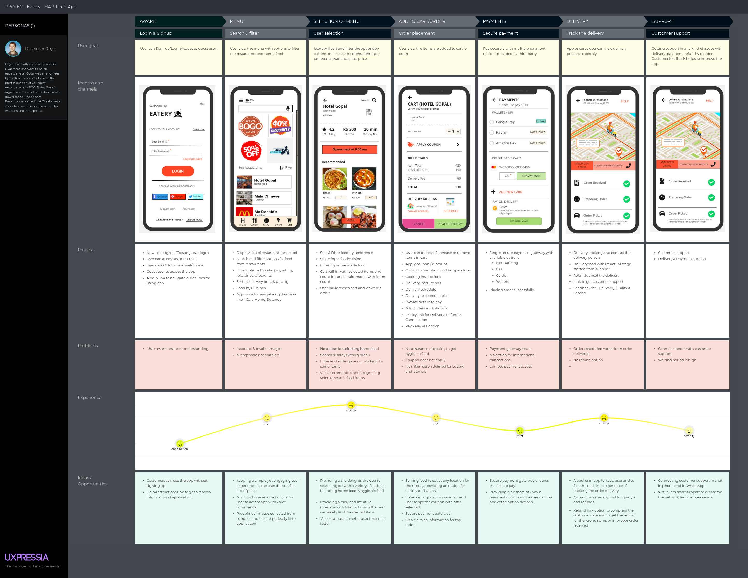
User Journey Map
Notes:
© Copyright UpGrad Education Pvt. Ltd. All rights reserved

Slide 31
Part 5: Minimum Viable Product Creation
Notes:
© Copyright UpGrad Education Pvt. Ltd. All rights reserved

Slide 32
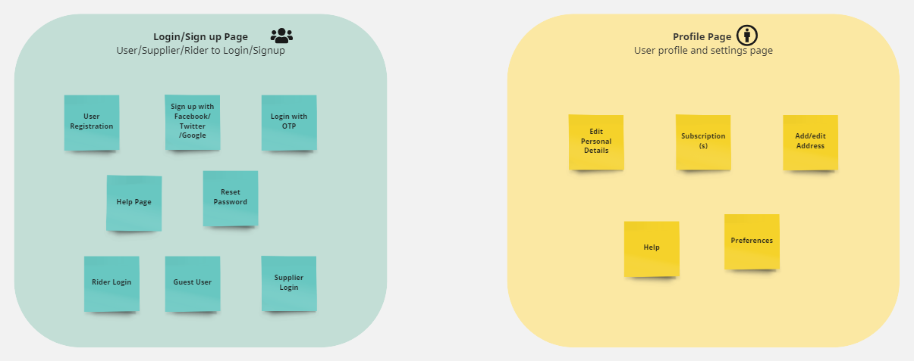
Features/Functionalities
Notes:
© Copyright UpGrad Education Pvt. Ltd. All rights reserved

Slide 33
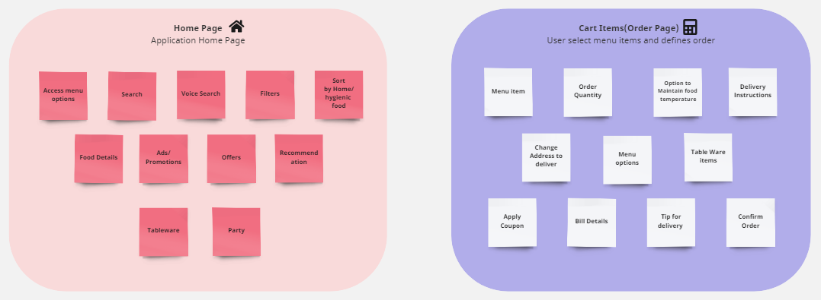
Features/Functionalities

Slide 34
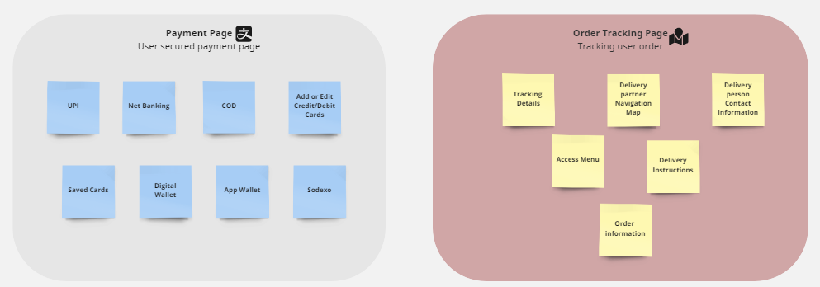
Features/Functionalities

Slide 35
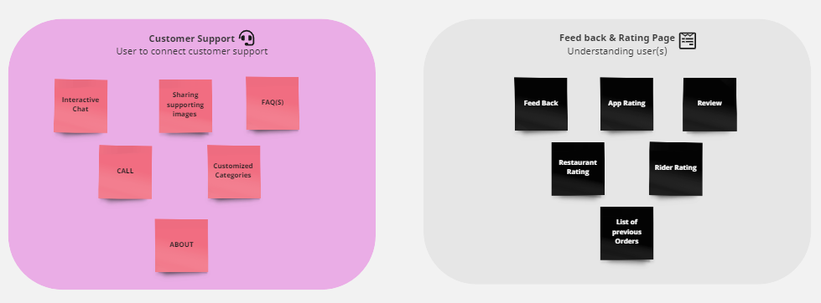
Features/Functionalities

Slide 36
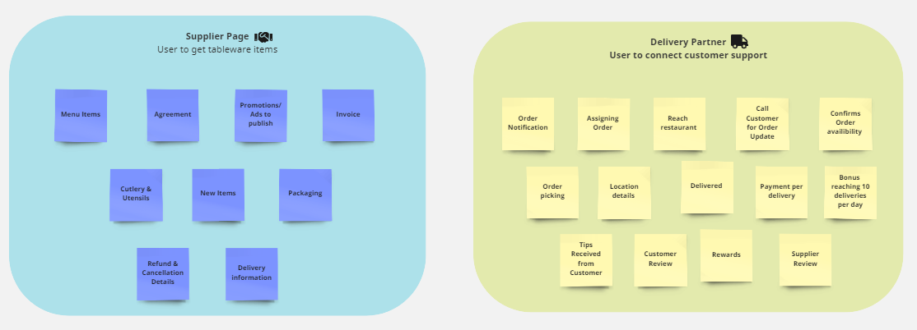
Features/Functionalities

Slide 37
Must Have Features
Feature | Reason behind choosing this as a ‘Must Have Feature’
Login as a customer/Supplier/rider | One interface for all 3 entities to access, supply and deliver the food. User can login with touch id or face id.
Search by Voice & Manual search | Voice search helps user to search the food with ease. We also have manual search that helps user to search manually
Signup | Customer will register with his Gmail/ Facebook/twitter/ mobile number and can have touch id or face id defined
Profile Page | Customer/Supplier/Rider – Address information, Contact information, Email, Subscription information for customers, Supplier & Rider agreement
Filter & Sorting | User can filter food type by category and sort by cost, rating & relevance . User can avail home and hygienic food.
Menu/Order | User select the items as per their need and should view the incremental cart qty
Cart Items | User should view the selected menu items and should view the quantity correctly displayed and can increase each item quantity.
Maintain food temperature option | User have a feature to maintain the food temperature by availing this option
Table ware items | User have a feature to add table ware items like – Plates, Cutlery, disposals…etc
Notes:
© Copyright UpGrad Education Pvt. Ltd. All rights reserved

Slide 38
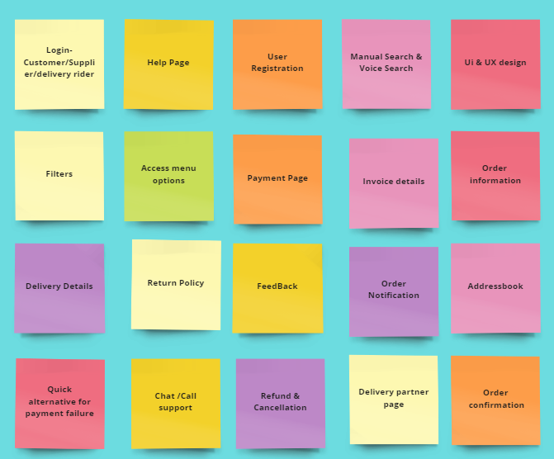
Must Have Features

Slide 39
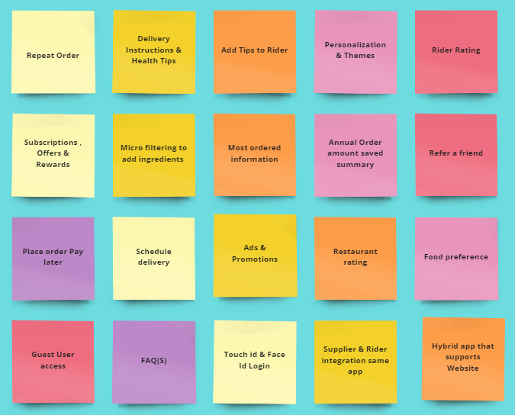
Nice to Have Features
Notes:
© Copyright UpGrad Education Pvt. Ltd. All rights reserved

Slide 40
Part 6: Sketching
Notes:
© Copyright UpGrad Education Pvt. Ltd. All rights reserved

Slide 41
Features
Page name | It’s Features/Functionalities
Login Page | User’s first interaction with the app upon launching. Users can choose to sign-up or login the app to get the best offers.
Signup Page | This helps user to register and become subscriber for application
Profile Page | User can edit/change/update profile information
Menu Page | A list of menu options to operate and use the application
Home Page | A list of restaurants and their offerings with menu options to utilize the application
Search Page | The search bar will give user the option to search for restaurants or dishes manually or through voice
Notes:
© Copyright UpGrad Education Pvt. Ltd. All rights reserved

Slide 42
Features
Page name | It’s Features/Functionalities
Filter/Sorting Page | User to filter or sort the food provider vendors on their preference
Add to cart Page | All food items listed in app will have add to cart option for the user selection
Cart Page | Selected item will display for user and can add/remove/update items. Order invoice will be displayed for payment
Empty Cart page | Page displays when user does not select items into cart . Page will suggest and user can schedule to add the food menu items.
Payments page | A secured payment gate way to customer with various payment methods to pay the order successfully
Delivery/Order tracking page | Tracks the order from source till delivered. User can contact delivery person for smooth handover.
Notes:
© Copyright UpGrad Education Pvt. Ltd. All rights reserved

Slide 43
Features
Page name | It’s Features/Functionalities
Feed Back | Helps to improve user experience .Helps to enhance app features.
Help & Support | Helps users to resolve problems. User can chat or call customer service to resolve their problems.
Cutlery Menu | A value added service to customer(s) to provide cutlery items for the order placed.
Supplier Page | Helps to have high retention suppliers. Supplier to access the supplier options and helps them to have marginal mutual benefits.
Delivery Person/Rider page | Helps the business to maintain delivery persons for the items to deliver. Delivery person to access his assigned orders, reach suppliers and will ensure business runs smoothly.
Delivery/Order tracking page | Tracks the order from source till delivered. User can contact delivery person for smooth handover.
Notes:
© Copyright UpGrad Education Pvt. Ltd. All rights reserved

Slide 44
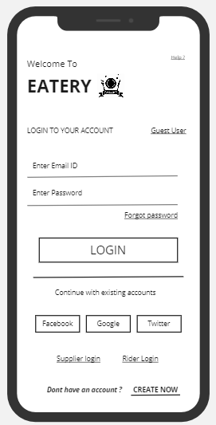
Login Page
Login page is first face after loading the app
Page help user to interact app as guest user
A subscribed user can login with his Email and password and can use his social ids to login
User can subscribe to the app by keying on create now option
Help will provide user information about the app
Notes:
© Copyright UpGrad Education Pvt. Ltd. All rights reserved

Slide 45
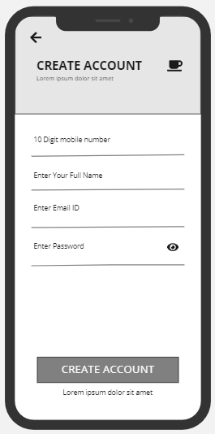
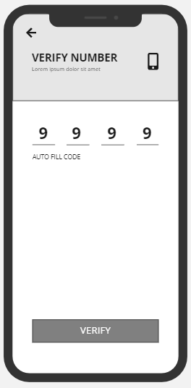
Signup Page
User can signup to application using his phone /email
User should verify the phone number to subscribe
Notification for phone OTP is received and will auto fill code

Slide 46
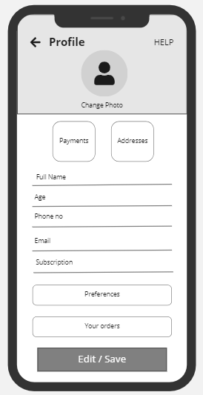
Profile Page
User profile page defines user information
User can view/edit/update his phone/email
User can view and edit is subscription plans
User can navigate, view and edit his default payment options
User can view/change is address

Slide 47
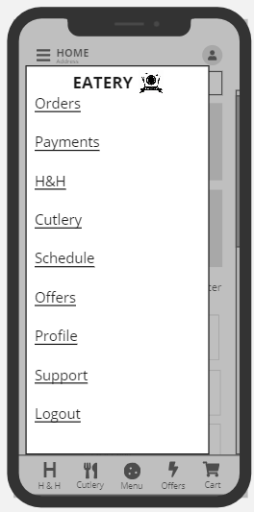
Menu Page
Menu option provides user access the app features
User can view his all order history
User can view/edit his all payment options
User can view/set his hygienic & home food
User can view and opt cutlery
User can schedule his order
User can view offers
User edit/view his profile
User can get customer support

Slide 48
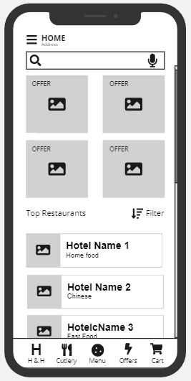
Home Page
Home page consist search and filter options
List of hotels
Menu icon on the top left
Menu options to navigate respective screens like – H&H, Cutlery, Menu, Offers & Cart page
Notes:
© Copyright UpGrad Education Pvt. Ltd. All rights reserved

Slide 49
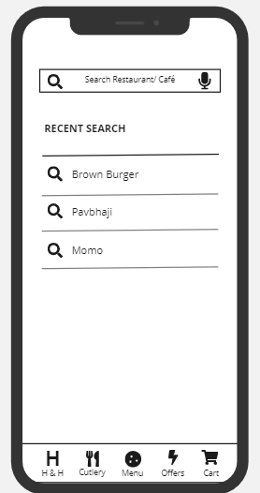
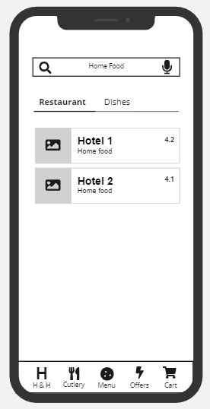
Search/voice search
User to search manually
User to search via voice over
User can search hotels
Search relevance and high rated hotels/café
User can view his recent search and can select his earlier preference
Menu options to navigate respective screens like – H&H, Cutlery, Menu, Offers & Cart page
Notes:
© Copyright UpGrad Education Pvt. Ltd. All rights reserved

Slide 50
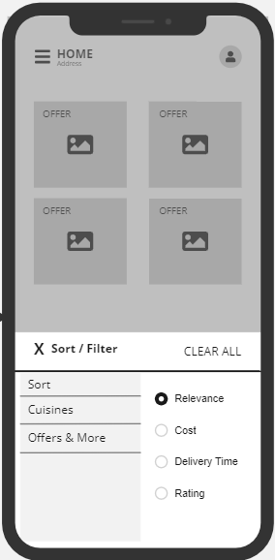
Filter & Sorting
App provides more filter & sorting options with ease
Relevance
Cost
Cuisines
Cutlery
Utensils
Delivery time
Ratings
Offers
User can clear his filters and redefine the options to select again
Notes:
© Copyright UpGrad Education Pvt. Ltd. All rights reserved

Slide 51
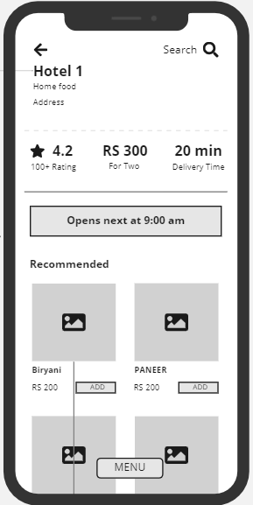
Add to cart
User selects hotel and view the hotel items to order
Hotel open/close timings
Rate hotel
Average cost
Delivery time
Recommended menu items
Food item and price tag
Add option to add in card
Lively menu items
Notes:
© Copyright UpGrad Education Pvt. Ltd. All rights reserved

Slide 52
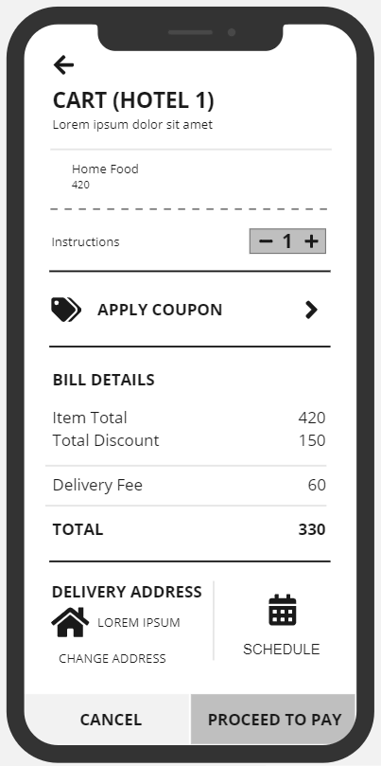
Cart
Cart page displays atleast one item is selected an order
Display Hotel information
Displays Hotel instructions
User can add/remove quantity
User view bill details to pay
User can view or change delivery address
User can schedule the order
User will two buttons to pay or cancel the order
Notes:
© Copyright UpGrad Education Pvt. Ltd. All rights reserved

Slide 53
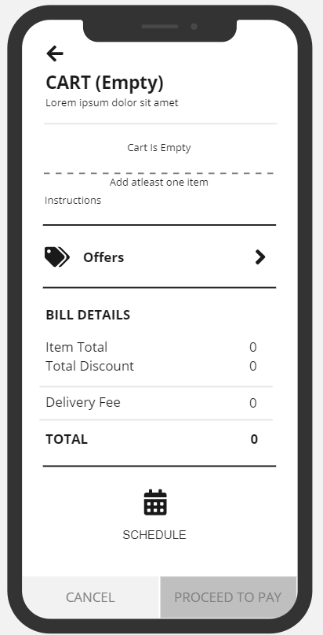
Empty cart
User may navigate this page with out selecting any order
User will view the page for no items in cart
User views the bill details as Zero
User can schedule an order
User will view two buttons to pay or cancel as disabled

Slide 54
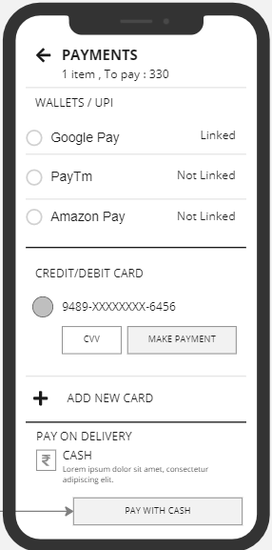
Payments page
A secured payment gate way defined for all users.
Successful payments for all user paying orders
Total item and to pay will display
Various payment methods to link and pay
1. UPI
2.CARD
3.COD
4.Cardless
Notes:
© Copyright UpGrad Education Pvt. Ltd. All rights reserved

Slide 55
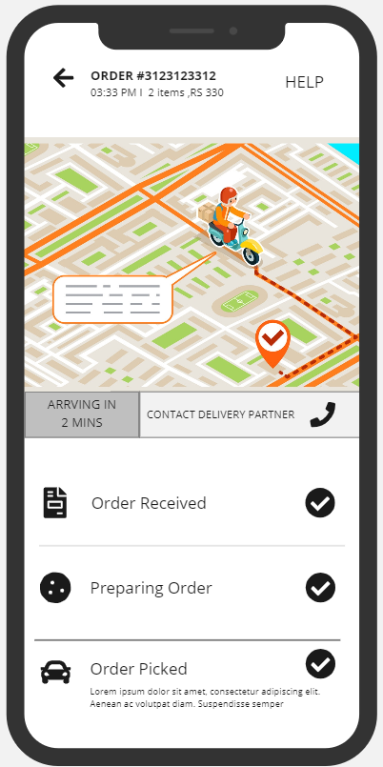
Delivery/Order tracking
Map that displays clearly to customer about the order delivery progress
Delivery/Rider person time information, duration to reach and contact details.
Order received indicates as green after supplier confirmation
Preparing order indicates as green after food ready
Order picked by delivery person indicates as green after once driver/rider pick the order
Help option to reach customer support
Notes:
© Copyright UpGrad Education Pvt. Ltd. All rights reserved

Slide 56
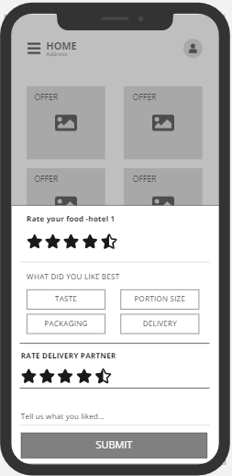
Feedback
Feed back to understand user experience and helps to enhance us more ideastic options in feature
Notes:
© Copyright UpGrad Education Pvt. Ltd. All rights reserved

Slide 57
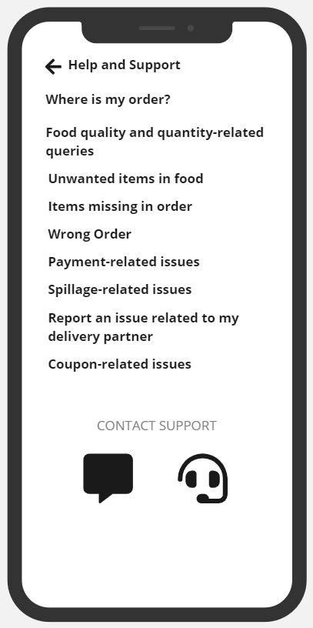
Help/support
A comprehensive help page with a list of FAQ(s) that helps user to understand better.
Most ranked FAQ(s) are listed and updated monthly
User can also contact support via phone or can chat for any kind of concerns with respective business.
Notes:
© Copyright UpGrad Education Pvt. Ltd. All rights reserved

Slide 58
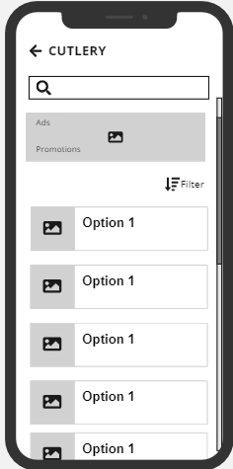
Cutlery Menu
A list of cutlery items menu
A value added service to help customers
List of items like –
1. Disposal plates
2. Spoons/Forks
3. Disposal glasses
Price tag for each items to select
Bill will update with list of price items selected.
Notes:
© Copyright UpGrad Education Pvt. Ltd. All rights reserved

Slide 59
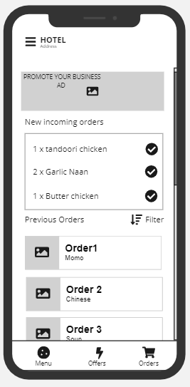
Supplier Page
Logins to app as supplier
Provide promotions to promote for customers
Track new and older orders
Provide offering based market margins
List of menu items they provide to serve customers

Slide 60
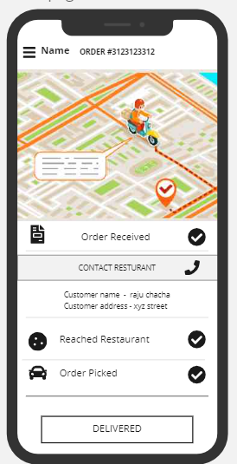
Delivery person/Rider Page
Logins to app as delivery/rider
Menu option to have Driver offerings
Driver/Rider name with order id details displays on screen
Receives order
Contact supplier and reaches
Map indication to reach supplier
Order picked
Map indication changes to reach customer
Delivered option will enable once delivery is delivered

Slide 61
Part 7: Wireframing and Prototyping
Notes:
© Copyright UpGrad Education Pvt. Ltd. All rights reserved

Slide 62
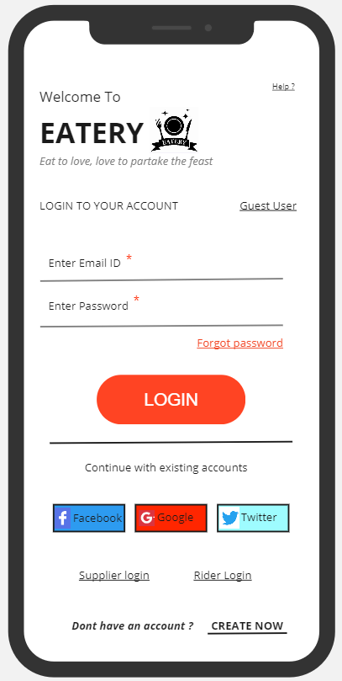
Login Page
Notes:
© Copyright UpGrad Education Pvt. Ltd. All rights reserved

Slide 63
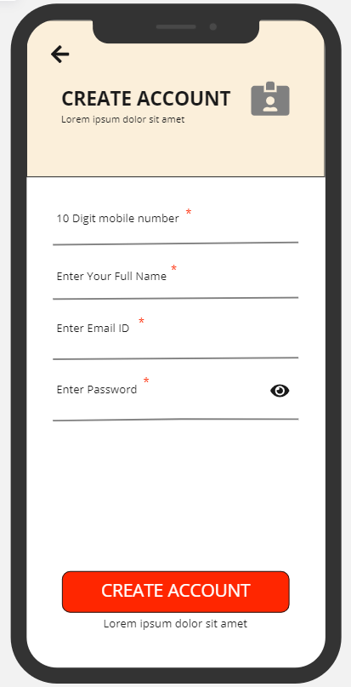
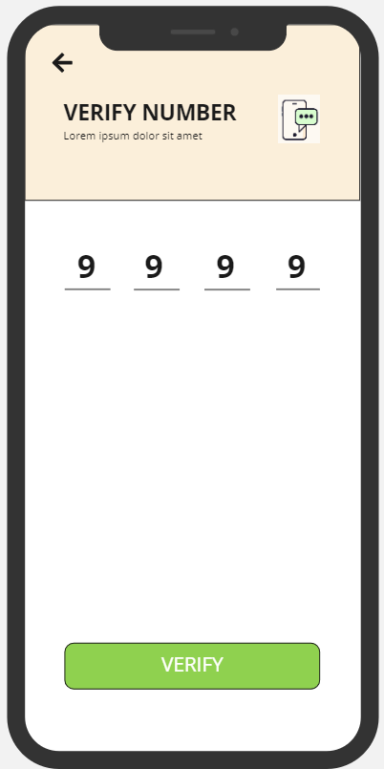
Signup Page

Slide 64
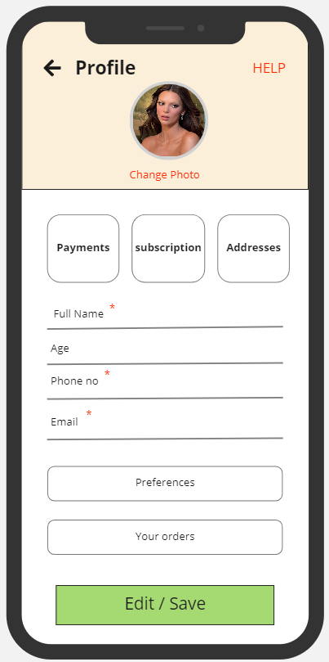
Profile Page

Slide 65
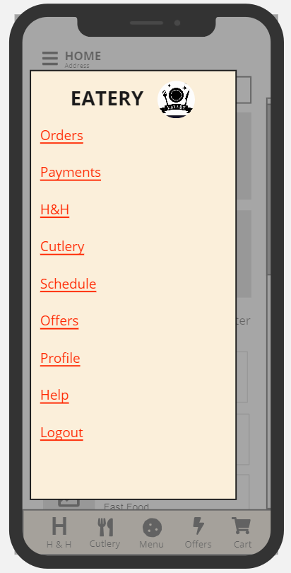
Menu Page

Slide 66
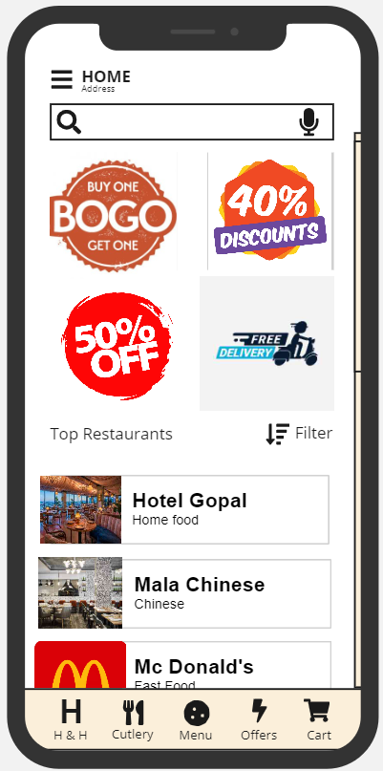
Home Page
Notes:
© Copyright UpGrad Education Pvt. Ltd. All rights reserved

Slide 67
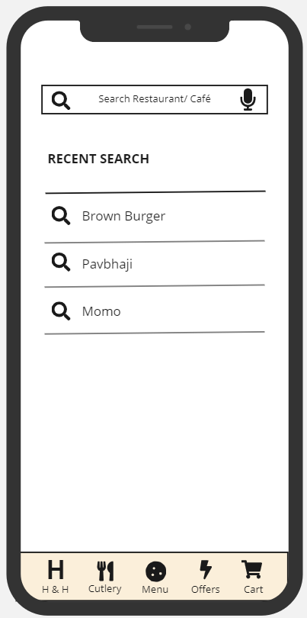
Search/Voice Search
Notes:
© Copyright UpGrad Education Pvt. Ltd. All rights reserved

Slide 68
Filter & Sorting
Notes:
© Copyright UpGrad Education Pvt. Ltd. All rights reserved

Slide 69
Add to cart
Notes:
© Copyright UpGrad Education Pvt. Ltd. All rights reserved

Slide 70
Cart
Notes:
© Copyright UpGrad Education Pvt. Ltd. All rights reserved

Slide 71
Empty cart

Slide 72
Payment page
Notes:
© Copyright UpGrad Education Pvt. Ltd. All rights reserved

Slide 73
Delivery/Order tracking
Notes:
© Copyright UpGrad Education Pvt. Ltd. All rights reserved

Slide 74
Feedback
Notes:
© Copyright UpGrad Education Pvt. Ltd. All rights reserved

Slide 75
Help/support
Notes:
© Copyright UpGrad Education Pvt. Ltd. All rights reserved

Slide 76
Cutlery Menu
Notes:
© Copyright UpGrad Education Pvt. Ltd. All rights reserved

Slide 77
Supplier Page

Slide 78
Delivery person/Rider Page

Slide 79
Navigational Flow
Notes:
© Copyright UpGrad Education Pvt. Ltd. All rights reserved

Slide 80
Prototype

Slide 81
Tools used
Wireframing | Miro
Prototyping | Miro
Notes:
© Copyright UpGrad Education Pvt. Ltd. All rights reserved

Slide 82
Prototyping
Prototyping | https://miro.com/app/board/uXjVP8hULEU=/
Notes:
© Copyright UpGrad Education Pvt. Ltd. All rights reserved

Slide 83
Disclaimer: All content and material on the UpGrad website is copyrighted material, either belonging to UpGrad or its bonafide contributors and is purely for the dissemination of education. You are permitted to access print and download extracts from this site purely for your own education only and on the following basis:
You can download this document from the website for self-use only.
Any copies of this document, in part or full, saved to disc or to any other storage medium may only be used for subsequent, self-viewing purposes or to print an individual extract or copy for non-commercial personal use only.
Any further dissemination, distribution, reproduction, copying of the content of the document herein or the uploading thereof on other websites or use of content for any other commercial/unauthorized purposes in any way which could infringe the intellectual property rights of UpGrad or its contributors, is strictly prohibited.
No graphics, images or photographs from any accompanying text in this document will be used separately for unauthorised purposes.
No material in this document will be modified, adapted or altered in any way.
No part of this document or UpGrad content may be reproduced or stored in any other web site or included in any public or private electronic retrieval system or service without UpGrad’s prior written permission.
Any rights not expressly granted in these terms are reserved.

